Slide 1
Part 3; progress, challenges & lessons
Steve Asten

Slide 2
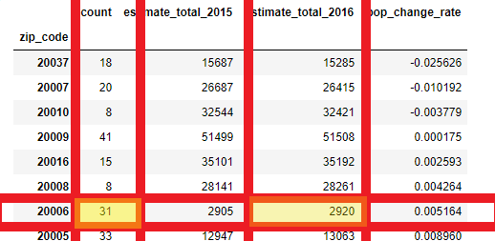
Progress 1: population is a bad indicator
Lots of tourist attractions in DC; some zip codes have very low population but very high traffic.

Slide 3
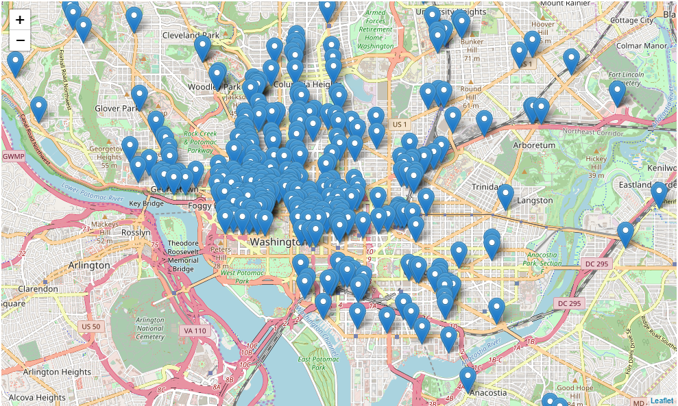
Progress 2: Found all current DC businesses (including coffee shops) using Yelp API
Currently I only have coffee shops plotted on the map. There’s a lot of them, making it impossible to decide on a location purely from visualization.

Slide 4
Progress 3: Discovered Foursquare dataset
I’m planning to use this to find where people are coming from when they go to a coffee shop; whether it’s a restaurant, movie theater, office, etc. This could help me predict the best location for my new coffee shop, based on current establishment locations.

Slide 5
Challenges/lessons
As we go through machine learning classes and learn new models, I’m still not entirely sure how I will apply them to my specific project.
Working with the foursquare dataset is very frustrating. It included a Cities table, but no foreign key in the check-ins table and thus no way to filter check-ins by city. Still trying to figure out how to efficiently geocode 250k sets of coordinates.
EDA for me has been difficult and unpredictable, and I should not have underestimated it when planning how much time I would put into it.
Yelp dataset was incomplete, and Yelp API only returns 50 results per search; need to use offsets & loops, which results in quickly using up daily-limit.

